Slide 1
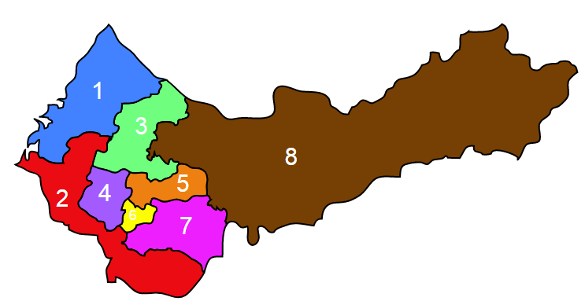
Network group project
Current status: (Total :8)
DPP*5, KMT*3 (ignore other partisan votes)
Government re-arrange distribution in 2006 (11 districts to 5 + (x-1,500,000)/300,000 districts
Goal:
Benefit to DPP: re-arrange district distribution to let DPP win
Benefit to KMT: re-arrange district distribution to let KMT win
Re-arrange districts: 2nd district is weird now(connect to coast area and mountain area

